Slide 1
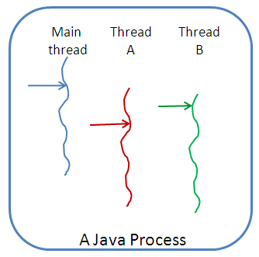
Java Multithreading & Concurrent Programming

Slide 2
Multitasking vs Multithreading vs Multiprocessing vs parallel processing
Multitasking: Ability to execute more than one task at the same time is known as multitasking.
Multithreading: It is a process of executing multiple threads simultaneously. Multithreading is also known as Thread-based Multitasking.
Multiprocessing: It is same as multitasking, however in multiprocessing more than one CPUs are involved. On the other hand one CPU is involved in multitasking.
Parallel Processing: It refers to the utilization of multiple CPUs in a single computer system.

Slide 3
What is a process?
A process consists of a memory space allocated by the operating system that can contain one or more threads.
The thread cannot exist on its own; it must be a part of a process.
A process remains running until all of the non-daemon threads are done executing.

Slide 4
What is a Thread?
The thread is a lightweight sub-process and the
smallest unit of execution.
Each thread has a separate path of execution.
It shares the memory area of the process.
A thread is a single sequential flow of control within
a program.
Thread does not have its own address space but
uses the memory and other resources of the
process in which it executes.
There may be several threads in one process
The Java Virtual Machine (JVM) manages and
schedules them for execution.

Slide 5
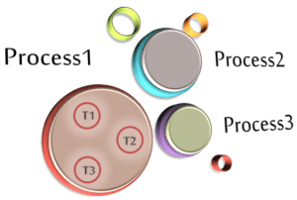
Java Process & Java Threads

Slide 6
What is Multithreading?
Multithreading is a conceptual programming paradigm where a program (process) is divided into two or more subprograms (process), which can be implemented at the same time in parallel.
For example, one subprogram can display an animation on the screen while another may play music.
A program that contains multiple flow of control is known as multithreaded program.
Since threads in java are subprograms of a main application program and share the same memory space, they are known as lightweight threads or lightweight processes.

Slide 7
‘threads running in parallel’ does not really mean that they actually run at the same time.
Since all the threads are running on a single processor, the flow of execution is shared between the threads. The java interpreter handles the switching of control between the threads in such a way that it appears they are running concurrently.
Multithreading enables programmers to do multiple things at one time.
For ex, we can send tasks such as printing into the background and continue to perform some other task in the foreground.
Threads are extensively used in java-enabled browser such as HotJava. These browsers can download a file to the local computer, display a web page in the window, output another web page to a printer and so on.
The ability of a language to support multithreads is referred to as concurrency.

Slide 8
What Are Pros And Cons Of Java Multithreading?
Pros.
General – It allows better use of system resources.
An important one – It allows parallel execution of tasks and thus saves
execution time.
It provides enhanced performance on multi-processor machines.
Improvised GUI responsiveness.
Threads are independent and do not impact other threads of the same
process if an exception occurs.
Multithreading doesn’t always yield benefits. It comes with its disadvantages too. Let us go through some of the typical after results.
Cons.
General – It results in the increased complexity of the code.
Synchronization of shared resources (objects, data) is CPU/memory intensive.
Debugging is hard because sometimes you can’t predict the results.
Increased potential for deadlock occurrence.
“Starvation” some of the threads may not be served with due to poor design.

Slide 9
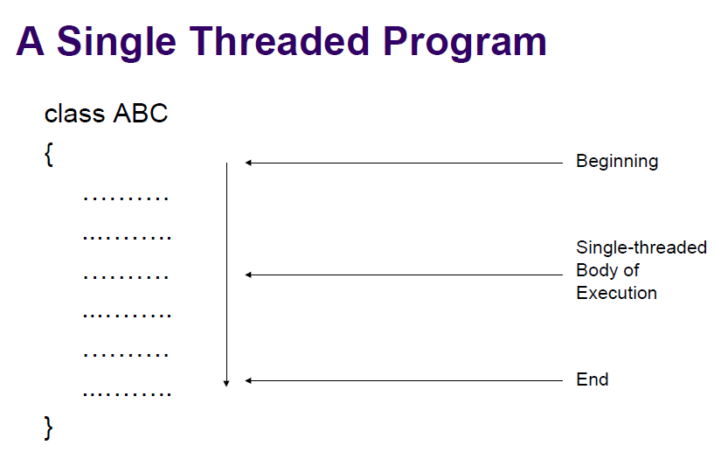
A Single Threaded Program

Slide 10
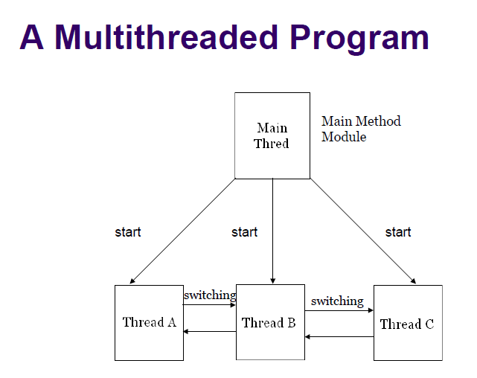

Slide 11
Thread Life Cycle
❑ During the life time of a thread, there are many
states it can enter. They include:
1. Newborn state
2. Runnable State
3. Running State
4. Blocked State
5. Dead State

Slide 12
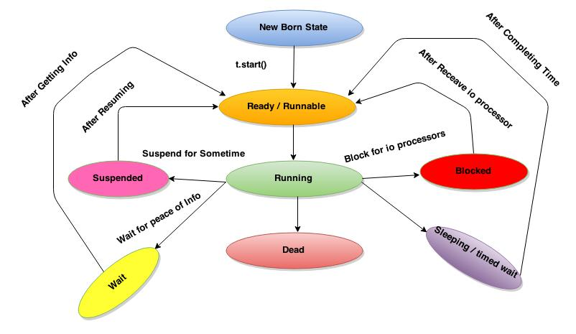
Thread Life Cycle

Slide 13
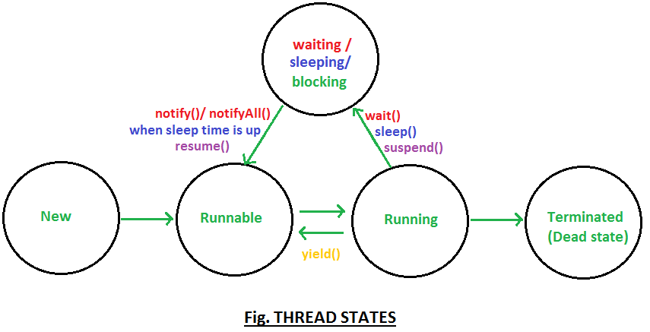
Thread Life Cycle

Slide 14
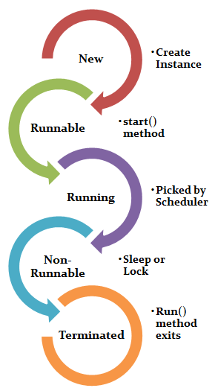

Slide 15
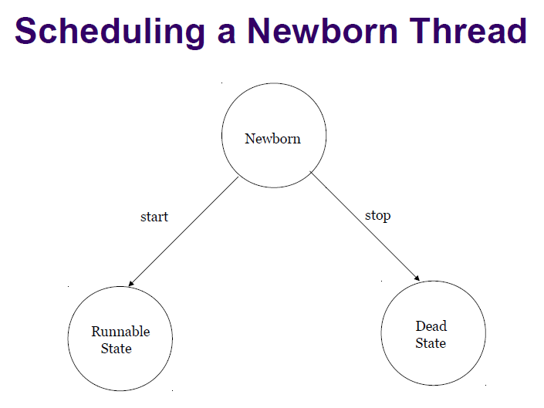
1. Newborn State
❑ When we create a thread object, the thread is born and is said to be in newborn state. The thread is not yet scheduled for running. At this state, we can do only one of the following with it:
Schedule it for running using start() method.
Kill it using stop() method
❑ If scheduled, it moves to the runnable state. If we attempt to use any other method at this stage, an exception will be thrown.

Slide 16
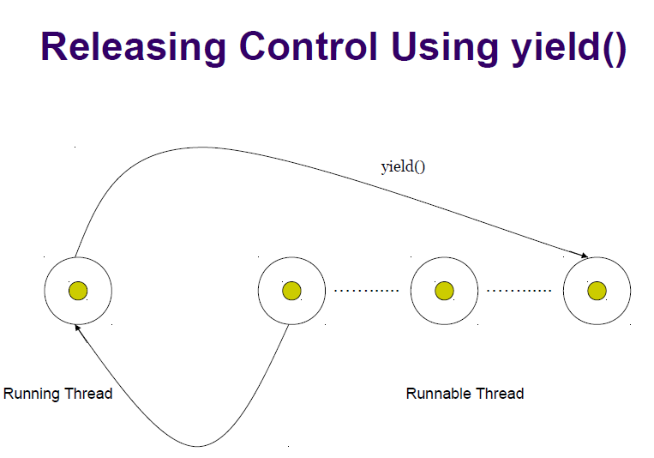
2. Runnable state (start())
❑ The runnable state means that the thread is ready for execution and is waiting for the availability of the processor.
❑ That is, the thread has joined the queue of threads that are waiting for execution.
❑ If all threads have equal priority, then they are given time slots for execution in round robin fashion. i.e. first-come, first-serve manner.
❑ The thread that relinquishes control joins the queue at the end and again waits for its turn. This process of assigning time to threads is known as timeslicing.
❑ If we want a thread to relinquish control to another thread of equal priority before its turn comes, we can do so by using the yield() method.

Slide 17
Running State
3. Running State
❑ Running means that the processor has given its time to the thread for its execution.
❑ The thread runs until it relinquishes control on its own or it is preempted by a higher priority thread.
❑ A running thread may relinquish its control in one of the following situations:

Slide 18
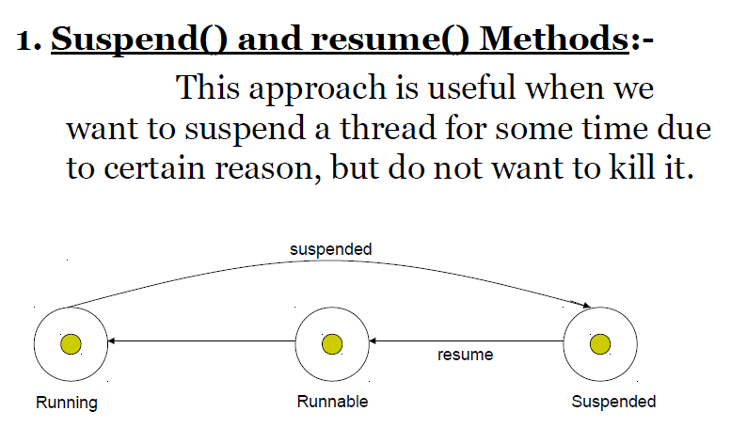
Suspend() and resume() Methods

Slide 19
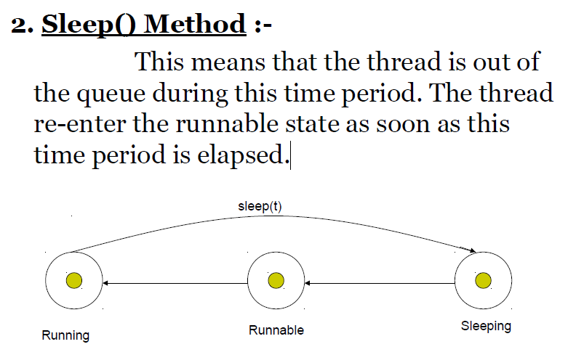
Sleep() Method

Slide 20
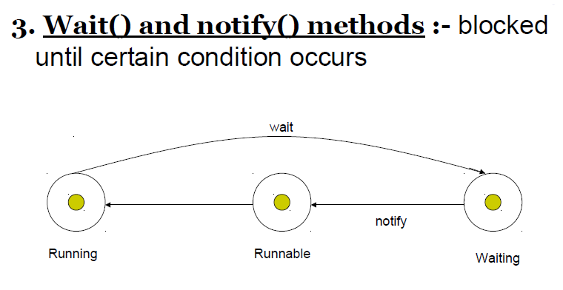
Wait() and notify() methods

Slide 21
Blocked State
4. Blocked State
❑ A thread is said to be blocked when it is prevented form entering into the runnable state and subsequently the running state.
❑ This happens when the thread is suspended, sleeping, or waiting in order to satisfy certain requirements.
❑ A blocked thread is considered “ not runnable” but not dead and therefore fully qualified to run again.

Slide 22
Dead State
5. Dead State
❑ A running thread ends its life when is has completed executing its run() method. It is a natural death.
❑ However, we can kill it by sending the stop message to it at any state thus causing a premature death to it.
❑ A thread can be killed as soon it is born, or while it is running, or even when it is in “not runnable” (blocked) condition.

Slide 23
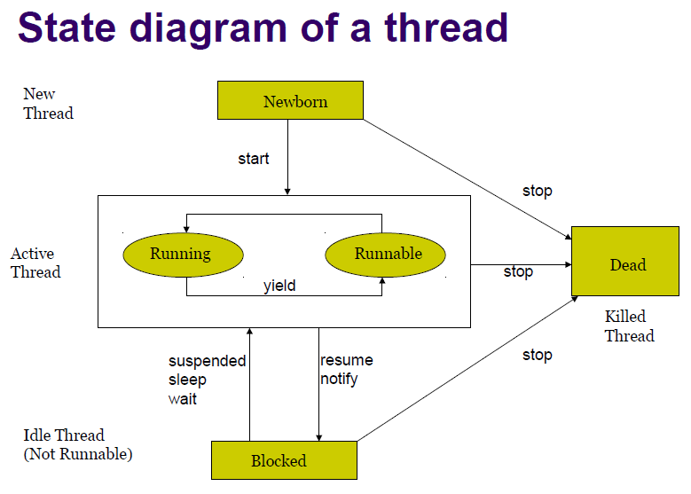

Slide 24
join() method
join() method :-
❑ The join method allows one thread to wait for the completion of another.
❑ If t is a Thread object whose thread is currently executing, t.join(); causes the current thread to pause execution until t's thread terminates.
❑ Overloads of join allow the programmer to specify a waiting period. However, as with sleep, join is dependent on the OS for timing, so you should not assume that join will wait exactly as long as you specify.
❑ Like sleep(), join responds to an interrupt by exiting with an InterruptedException

Slide 25
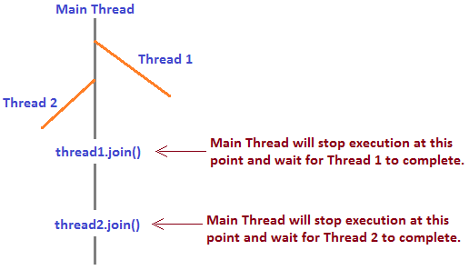
join() method

Slide 26
Creating Threads
Creating Threads
Thread class in the java.lang package allows you to create and manage threads.
Each thread is a separate instance of this class.
A new thread can be created in two ways:
1. By extending a Thread class
2. By implementing an Runnable interface

Slide 27
Extending the Thread class
We can directly extend the Thread class
class MyThread extends Thread {
public void run() {
//logic for the thread
}
}
The class MyThread extends Thread.
The logic for the thread is contained in the run() method.
It can create other objects or even initiate other threads.

Slide 28
Implementing Runnable Interface
❑ Declare a class that implements the Runnable interface.
❑ This declares only one method as shown here:
public void run();
class RunnableY implements Runnable {
public vod run() {
// logic for thread
}
}

Slide 29
Method 1: Thread creation by extending Thread class
class Multithreading extends Thread {
public void run() {
System.out.println("My thread is in running state.");
}
public static void main(String args[]) {
Multithreading t1 = new Multithreading();
t1.start();
}
}
Output: My thread is in running state.
MultiThreadingUsingThread.java
MultiThreadingUsingRunnable.java
CountingThreads.java

Slide 30
Run()
This method is the Entry point for the thread.
Let’s see a sample code that shows how to use the start() and run() methods.
class MultithreadDemo extends Thread{
public void run(){
System.out.println("My thread is in running state.");
}
public static void main(String args[]){
MultithreadDemo obj=new MultithreadDemo();
obj.start();
}
}
Output:
My thread is in running state.

Slide 31
❑ The application can start an instance of the thread by using the following code:
RunnableY ry = new RunnableY();
ThreadY ty= new Thread(ry);
Ty.start();
❑ 1st line instantiate the RunnableY class.
❑ 2nd line instantiate the Thread class. A reference to the RunnableY object is provided as the argument to the constructor.
❑ Last line starts the thread.

Slide 32
Stopping a Thread
✓ Whenever we want to stop a thread form running
further, we may do so by calling its stop() method
like:
t1.stop();
✓ The stop() method may be used when the premature death of a thread is desired

Slide 33
Blocking a Thread
✓ A thread can also be temporarily suspended or blocked form entering into the runnable and subsequently running state by using either of the following thread methods:
sleep() – blocked for a specified time.
suspend() – blocked until further orders.
wait() – blocked until certain condition occurs.
These methods cause the thread to go into the blocked state. The thread will return to the runnable state when the specified time is elapsed in the case of sleep(), the resume() method is invoked in the case of suspend(), and the notify() method is called in the case of wait().

Slide 34
Thread class
Some of the constructors for Thread are as follows:
● Thread()
● Thread(Runnable r)
● Thread(Runnable r, String s)
● Thread(String s)
Here, r is a reference to an object that implements the Runnable interface and s is a String used to identify the thread.

Slide 35
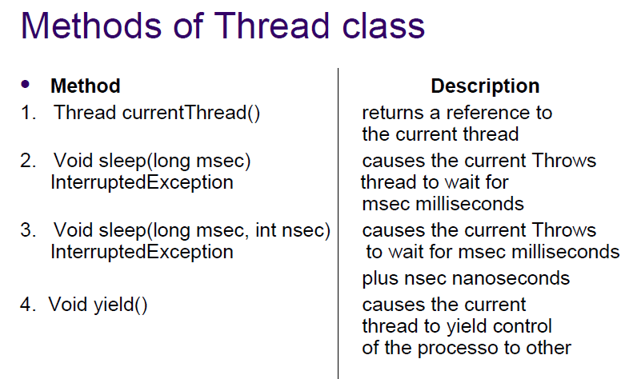

Slide 36
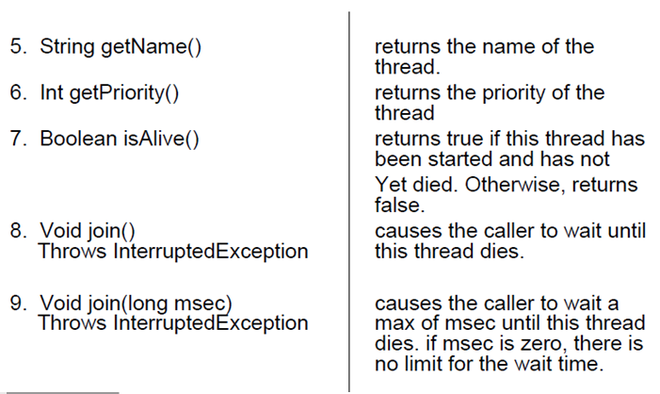

Slide 37
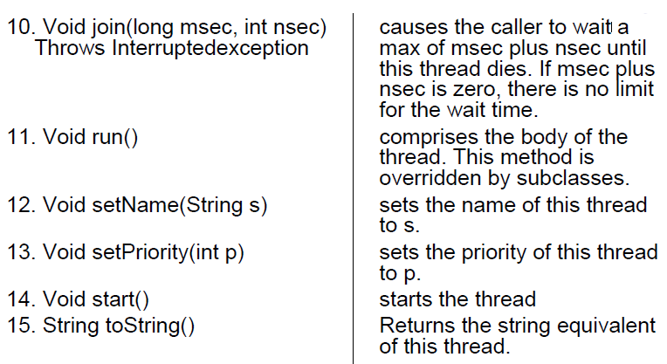

Slide 38
Thread Priority
● In java, each thread is assigned a priority, which affects the order in which it is scheduled for running.
● Java permits us to set the priority of a thread using the setPriority() method as follows:
ThreadName.setPriority(intNumber);
● The intNumber may assume one of these constants or any value between 1 and 10.
● The intNumber is an integer value to which the thread’s priority is set. The Thread class defines several priority constants:
● MIN_PRIORITY=1
● NORM_PRIORITY=5
● MAX_PRIORITY=10
● The default setting is NORM_PRIORITY.

Slide 39
Synchronization
✓ When two or more threads need access to a shared resource, they need some way to ensure that the resource will be used by only one thread at a time. The process by which this is achieved is called synchronization.
✓ This can be done in two ways. First, a method can be synchronized by using the synchronized keyword as a modifier in the method declaration.
✓ When a thread begins executing a synchronized instance method, it automatically acquires a lock on that object.
✓ The lock is automatically relinquished when the method completes.
✓ Only one thread has this lock at any time.
✓ Therefore, only one thread may execute any of the synchronized instance methods for that same object at a particular time.
Another way to synchronize access to common data is via a synchronized statement block. This has the following syntax:
synchronized(obj) {
//statement block
}

Slide 40
Dead Lock
✓ Deadlock is an error that can be encountered in multithreaded programs.
✓ It occurs when two or more threads wait for ever for each other to relinquish locks.
✓ Assume that thread1 holds lock on object1 and waits for a lock on object2. thread2 holds a lock on object2 and waits for a lock on object1. neither of these threads may proceed. Each waits forever for the other to relinquish the lock it needs.
Deadlock situations can also arise that involve more than two threads. Assume that thread1 waits for a lock held by thread2. thread2 waits for a lock held by thread3. thread3 waits for a lock held by thread1.

Slide 41
Thread Communication
● Polling is usually implemented by a loop that is used to check some condition repeatedly. Once the condition is true, appropriate action is taken. This wastes CPU time.
● For example, consider the classic queuing problem, where one thread is producing some data and another is consuming it.
● In a polling system, the consumer would waste many CPU cycles while it waited for the producer to produce.
Once the producer was finished, it would start polling, wasting more CPU cycles waiting for the consumer to finish, and so on. Clearly, this situation is undesirable. To avoid polling, Java includes an elegant inter-process communication mechanism via the wait( ), notify( ), and notifyAll( ) methods. These methods are implemented as final methods in Object, so all classes have them.
● All three methods can be called only from within a synchronized method.

Slide 42
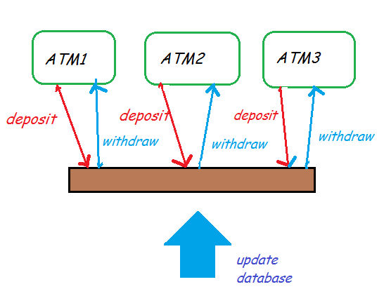
Multi-threading for update an Account Management System

